Slide 1
DATA-CAN PPIE Drop-in session “Data and inequality”

Slide 2
Areas to cover
What do we mean by equality data
What are the legal requirements
What data is available to monitor these, and where is it?

Slide 3
A legal duty – Equalities Act 2010
The Equalities Act 2010 and protected characteristics
Data recorded in the cancer dataset and by the cancer registry
age;
sex;
sexual orientation.
gender reassignment;
disability;
marriage and civil partnership;
pregnancy and maternity;
race;
religion or belief;
Yes
Yes
Yes
No
No. Only in community services, HIV/AIDS, IAPT and mental health
Yes. In admitted patient care data (and mental health data)
NO, but held in maternity datasets
NO, but ethnicity is well recorded
NO

Slide 4
A legal duty – Health and Social Care Act 2012
The Health and Social Care Act 2012
introduced the first specific legal duties on health inequalities, including duties on the Secretary of State
All staff undertaking NHS and public health functions on behalf of the Secretary of State are responsible for ensuring compliance with these duties. A breach of these requirements could result in a judicial review
Health data is essential to identify and quantify health inequalities, including planning health policy, evaluating the impact of policy, and tracking changes over time

Slide 5
A practical duty
“An Equality Impact Assessment is an essential part of identifying and assessing relevant evidence on the proposed new initiatives to improve cancer services, helping the NHS meet its duties in relation to equality legislation and regulations”
Equality Impact Assessment, England Cancer Strategy (2015-2020)
Notes:
https://www.cancerresearchuk.org/sites/default/files/taskforce_equality_impact_assessment.pdf

Slide 6
What data is available about equality dimensions?
Age
Sex
Deprivation
Ethnicity
Sexuality
And what about
Disability?
Homelessness?
Travellers?
Incidence
Mortality
Survival
Prevalence
Screening
Route to diagnosis
Stage at diagnosis
Treatments
Access to clinical trials
Experience

Slide 7
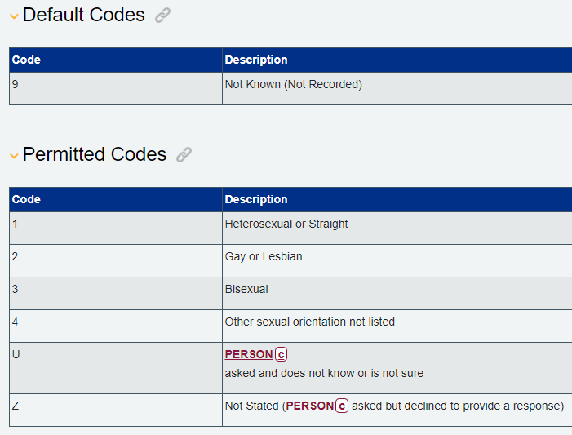
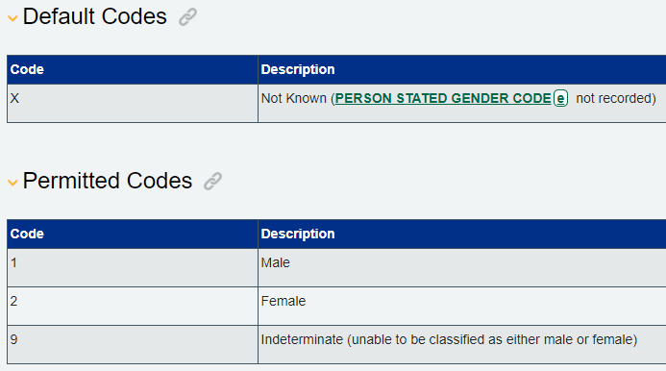
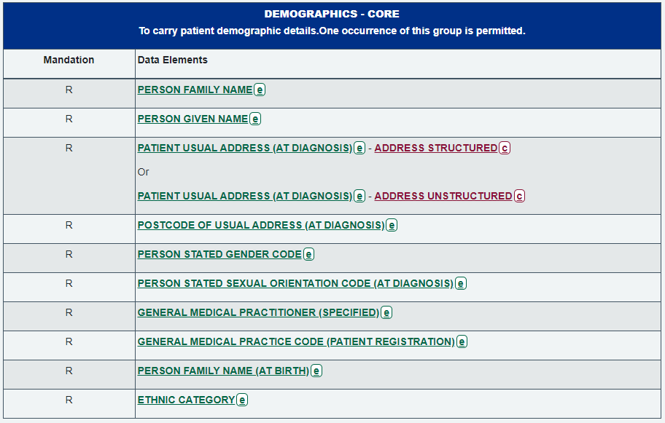
A look at sex, gender, sexual orientation
This is the NHS Data Dictionary
It shows just one part of the cancer dataset, for demographic data
One field records the gender for the patient
It shows what the permitted values are
There is another field for sexual orientation
These are both held by the cancer registry

Slide 8
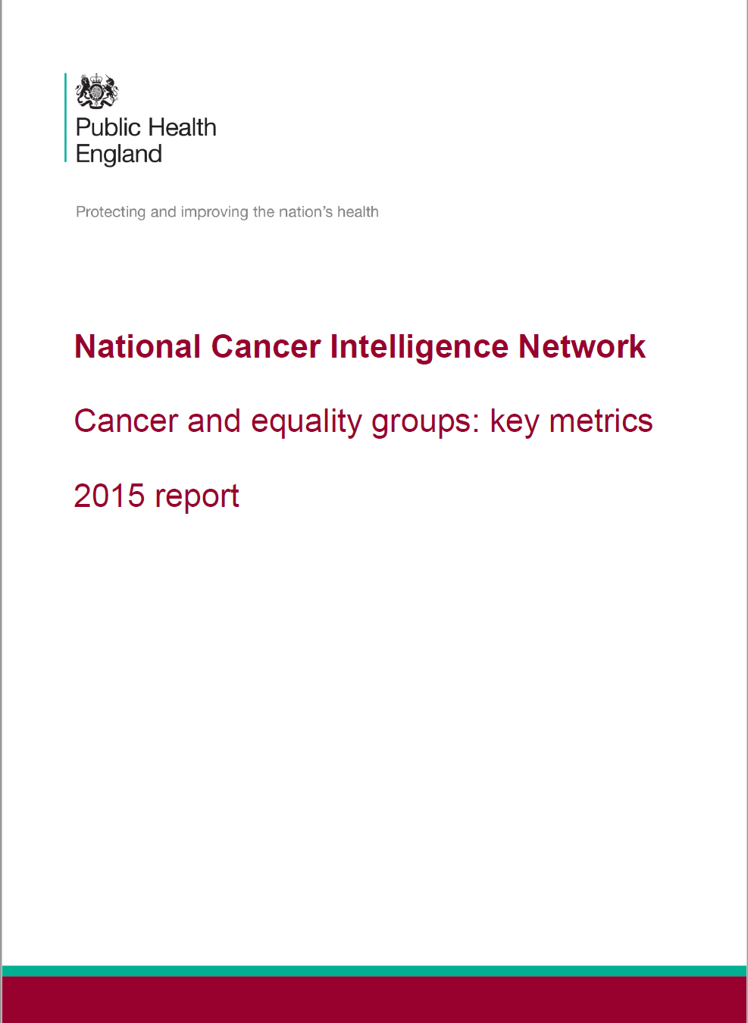
And what do we know?

Slide 9
Take away points
There are a wide range of dimensions of “equality”
Data exists to monitor most of these, but some of the data is not linked
We have lots of published analysis of equality in diagnosis, care, outcomes and experience
We should always think about whether a piece of analysis/research could cover more of the equality dimensions

